Slide 1


2nd World Conference on Communication & Computing 2024 (2nd WCONF 2024)
North Indian Ocean Tropical Cyclone Detection Using YOLOv5
Paper ID: 298
Manish Mawatwal
IIT Indore

Slide 2
Presentation Outline
Motivation
Existing Techniques
Need for Image Analysis
Dataset
Methodology
Results
References

Slide 3
Motivation
1,408
billion in economic losses
8 lac
People killed
Bangladesh
Most affected by TC
Quick Response and evacuation from NDMA, GoI
Prevent socio-economic loss
Reroute ships and fishermen in open oceans
Understanding cyclogenesis
Stop false alarms
Early warning messages
78
Million damages every day
1,942
disasters
43
Deaths every day
3

Slide 4
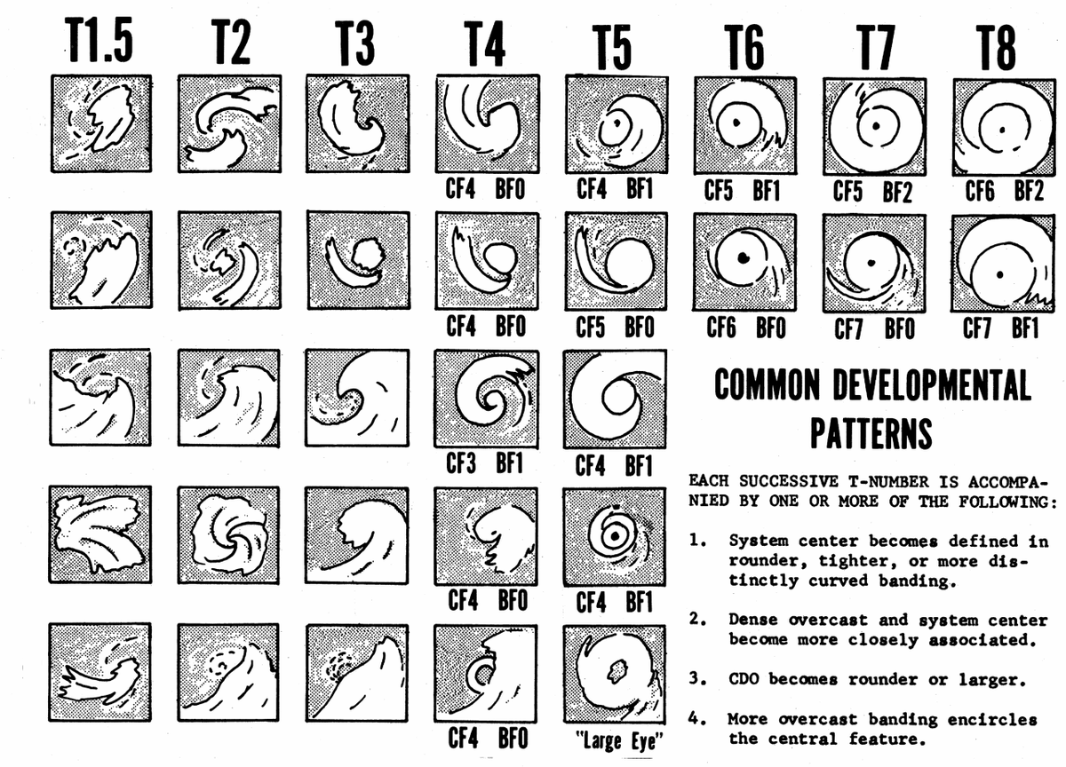
EXISTING TECHNIQUES
Technique | Limitation
Dvorak Technique | Human intervention leads to differences in assigning T-number.
Advanced Dvorak Technique | Performance is bad during smaller cyclones or disordered cloud.
Deviation Angle | Models and parameters are different for different locations.
Passive Microwave Imagery-Based Tropical Cyclone Intensity Estimation. | Intensity estimation depends on frequency of observations.
Convolutional Neural Network | Requires a large amount of dataset
Research Gaps
Cyclones cross oceans, information transfer between storms from different basins is difficult
Complex and nonlinear relationships between TC parameters
Inaccurate vortex initialization, incomplete knowledge of complex physical processes.
4

Slide 5
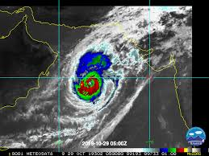
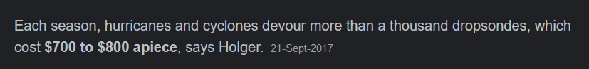
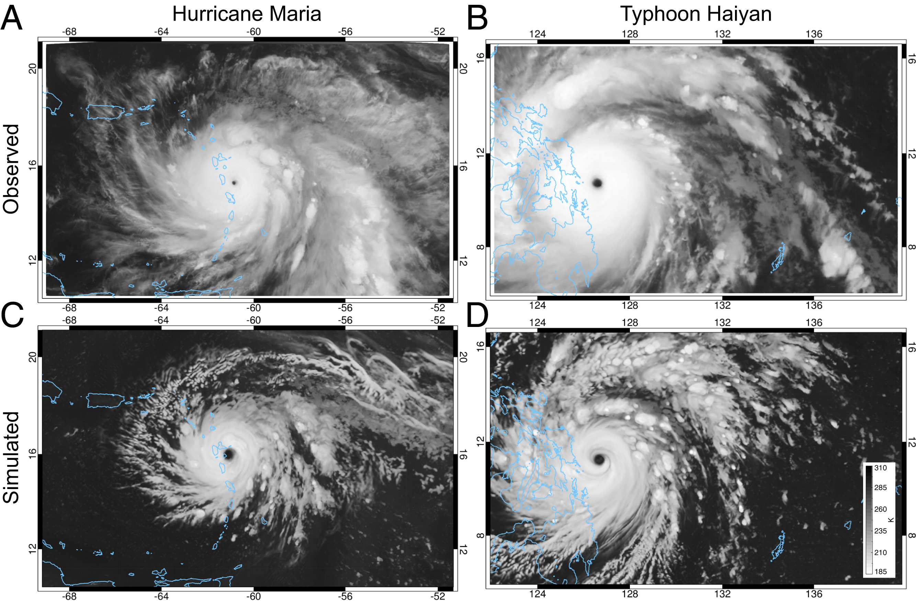
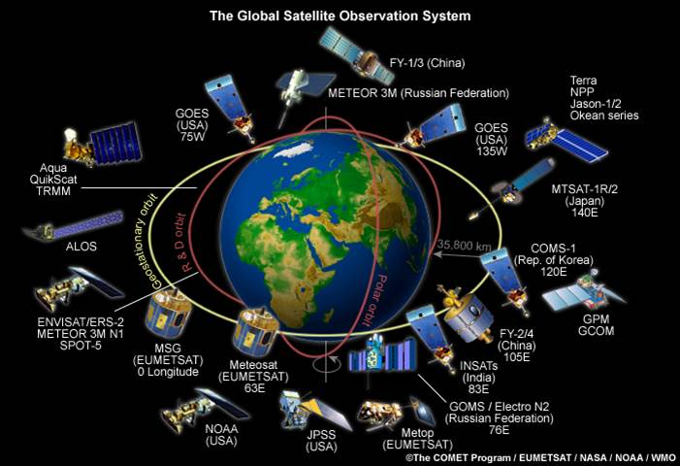
Need for image analysis
Reasons
Costly devices
Huge number of Global Satellite system
In-situ availability of cyclone images.
Image Sources:
Global Weather and Climate Center (Top left)
Image Courtesy: http://www.fe-lexikon.info/ (Bottom left), https://doi.org/10.1073/pnas.2013584117 (Bottom right)
5

Slide 6
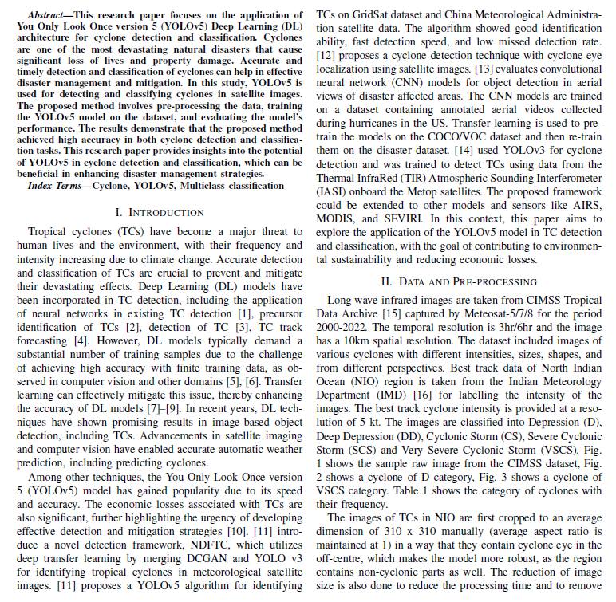
North Indian Ocean Tropical Cyclone Detection Using YOLOv5
6

Slide 7
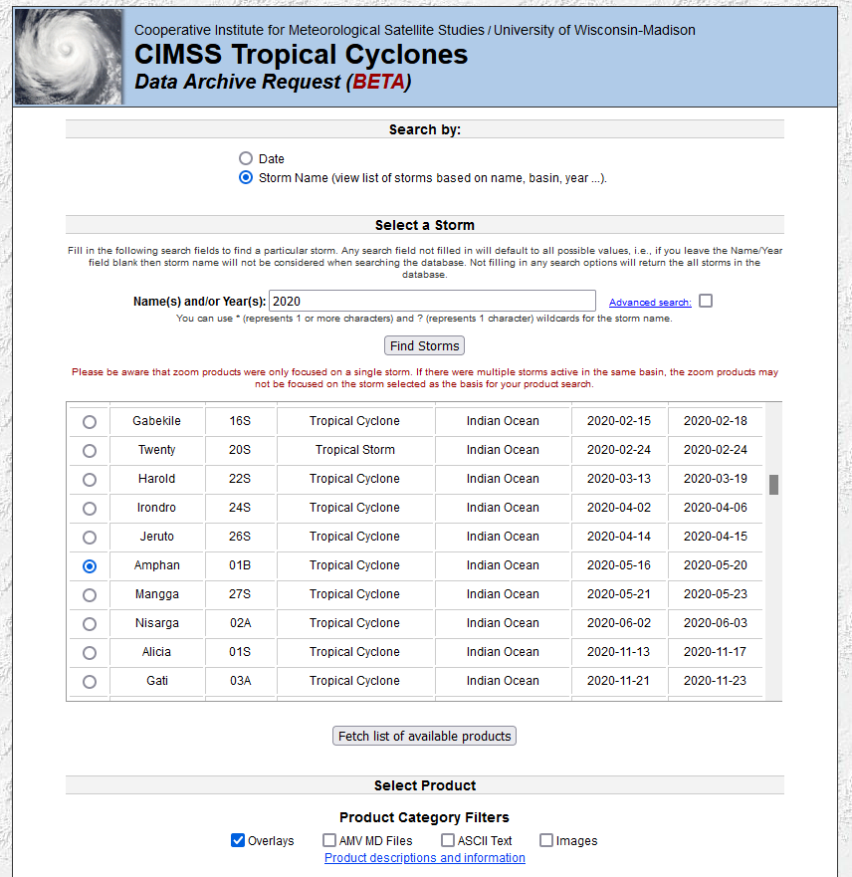
Dataset (1/4)
Source
Infrared images taken from CIMSS Tropical Data Archive (Satellite: Meteosat 5/7/8)
Features
Doesn’t have centre cyclone, data augmentation improves performance
Characteristics
Temporal resolution is 3hr/6hr
Images are in Grayscale and cropped with non cyclonic parts
Best Track Cyclone data is taken from IMD website for labelling the intensity.
Image is cropped to a resolution of 310x310 keeping cyclone within 3X3 grid.
Cropped region : 40E to 100E, 10S to 20N
Focused area: Bay of Bengal and Arabian Sea
Each image contains the name of the satellite, type of image, time and date
Fig: CIMSS Tropical Cyclones Website
7

Slide 8
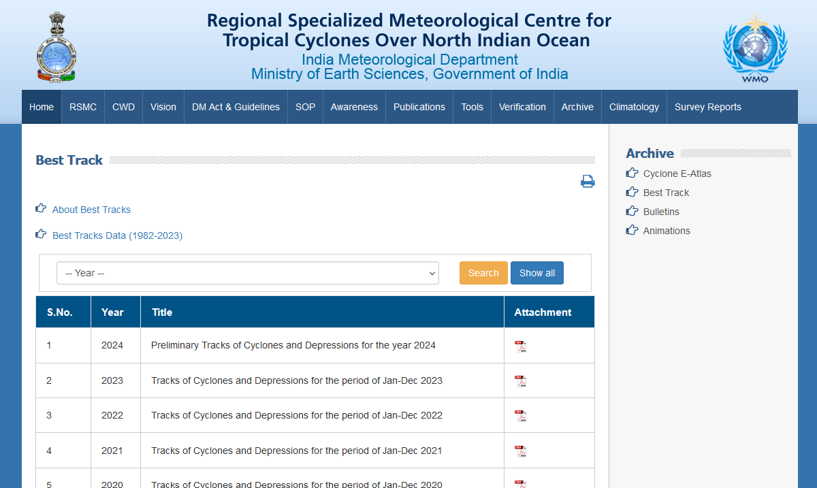
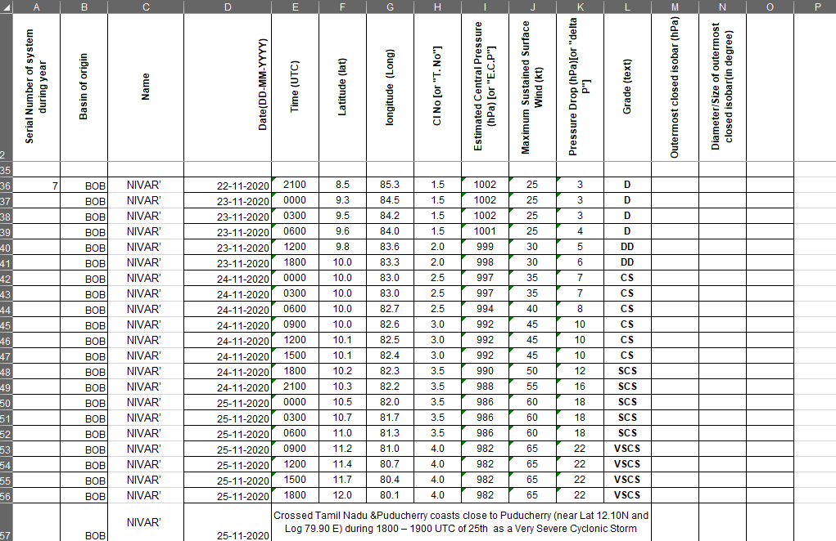
Dataset (2/4)
Fig: RSMC New Delhi Website
Fig: Best Track Cyclone Dataset
Problems in Data Collection
Missing information of some of the cyclones in Best Track RSMC New Delhi data hence the images from these cyclones cannot be annotated with MSW speeds.
MSW data of cyclones after it crosses the coast/landfalls is not available in most cases which might lead to inaccuracies in annotating the images/classifying the images into different classes.
For some temporal resolution(3hr/6hr) the best track data is not available.
Missing data in images which creates problem in training NN and hence are removed from the dataset. The data has to be cleaned before fitting on model.
8

Slide 9
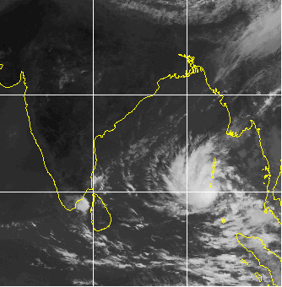
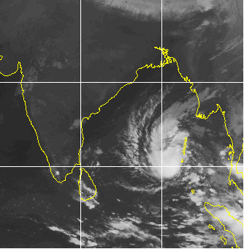
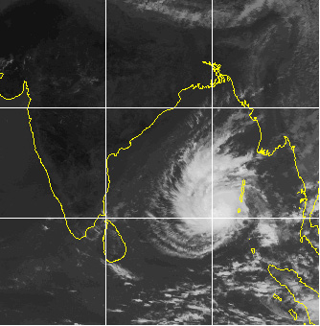
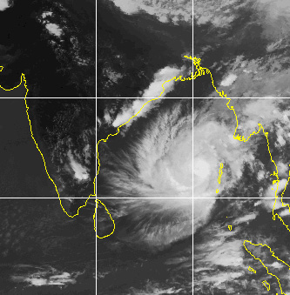

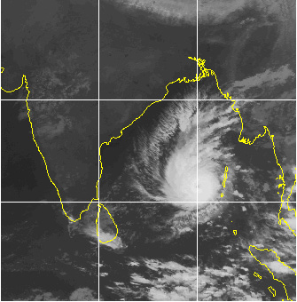
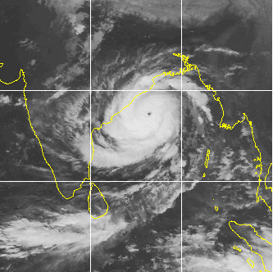
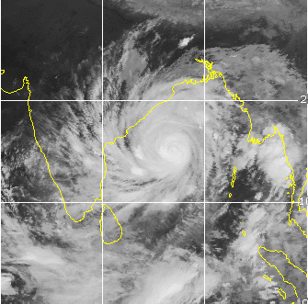
Dataset(3/4)
Depression (20-25 knots)
Deep Depression (30-35 knots)
Cyclonic Storm (40-50 knots)
Severe Cyclonic Storm (55-65 knots)
Very Severe Cyclonic Storm (70-90 knots)
Extremely Severe Cyclonic Storm (95-120 knots)
Super Cyclonic Storm (125+ knots)
9

Slide 10
Dataset(4/4)
Table: Category of cyclones (Multiclass classification)
Category | Wind Speed | Actual Images
Depression (D) | 20-25 knots | 352
Deep Depression (DD) | 30-35 knots | 534
Cyclonic Storm (CS) | 40-50 knots | 396
Severe Cyclonic Storm (SevereCS) | 55-65 knots | 257
Very Severe Cyclonic Storm (VSCS) | 70+ knots | 305
Table: Cyclone data table across the years
Year | Cyclone Number
2012 | 02B (Nilam), 01A (Murjan)
2013 | 01B (Mahasen), 02B (Phailin), 04B (Helen), 05B (Lehar), 06B (Madi)
2014 | 01B, 02A, 03B (Hudhud), 04A (Nilofar), 05B
2015 | 01A (Ashobaa), 02B (Komen), 03A, 04A (Chapala), 05A (Megh)
2016 | 01B (Roanu), 02A, 03B (Kyant), 04B (Nada), 05B (Vardah)
2017 | 01B (Maarutha), 02B (Mora), 03B (Ockhi), 04B
2018 | 01A (Sagar), 02A (Mekunu), 04B (Daye), 05A (Luban), 06B (Titli), 07B (Gaja), 08B (Phethai)
2019 | 01B (Fani), 02A (Vayu), 03A (Hikaa), 04A (Kyaar), 05A (Maha), 06A (Pawan), 07A
2020 | 01B (Amphan), 02A (Nisarga), 03A (Gati), 04B (Nivar), 05B (Burevi)
2021 | 01A (Tauktae), 02B (Yaas), 03B (Gulab), 03A (Shaheen)
2022 | 01B, 02B(Asani)
Year | Cyclone Number
2000 | 04B
2001 | 01A
2003 | 01B, 03B
2004 | 01A, 05A (Agni), 01B
2005 | 06B (Fanoos), 05B (Baaz)
2006 | 02B (Mala)
2007 | 02A (Gonu), 06B (Sidr)
2008 | 01B (Nargis), 04B (Rashmi), 05B (Khai-Muk), 06B (Nisha)
2009 | 01B (Bijli), 02B (Aila), 05B (Ward)
2010 | 01B (Laila), 02A (Bandu), 03A (Phet), 04B (Giri), 05B (Jal)
2011 | 03A (Keila), 06B (Thane)
10

Slide 11
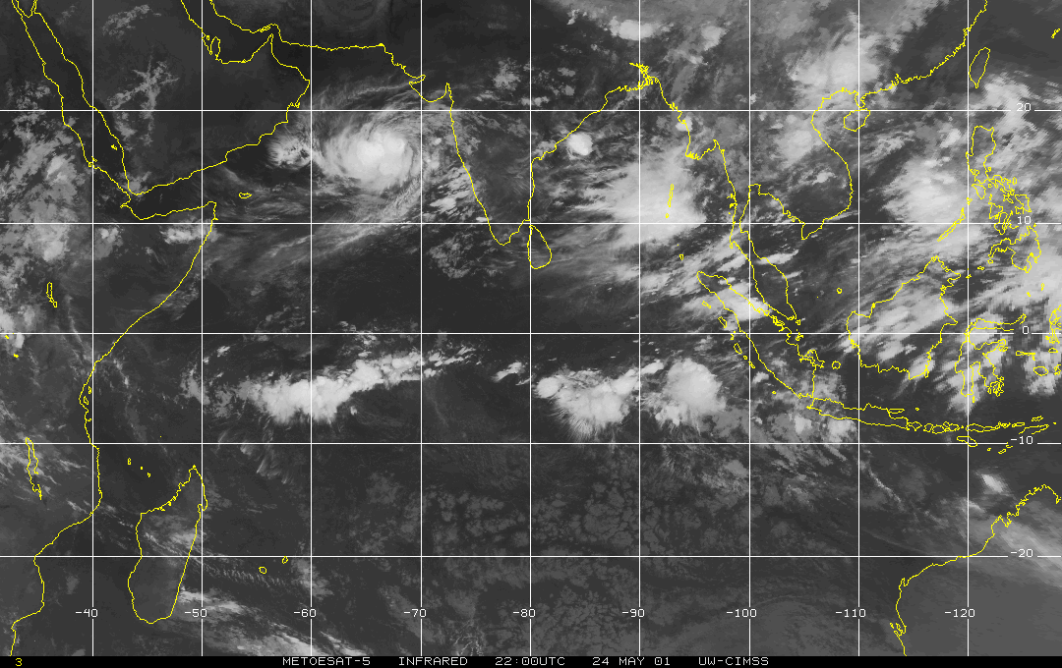
Cyclone
Latitude
Arabian Sea
Bay of Bengal
Longitude
Fig: Raw image file from CIMSS data archive
11

Slide 12
Methodology using YOLOv5 Architecture
Images from CIMSS Tropical Data Archive captured Meteosat-5/7/8 for the period of 2000-2022.
Best Track data of NIO region is taken from the IMD for labelling the intensities of the images.
Hyperparameter Tuning
Resized image: 640x640
Confidence threshold for object detection: 0.25
IoU threshold used for assigning ground truth boxes to anchor boxes: 0.2
Initial Learning rate: 0.01
Final Learning rate: 0.001
No. of epochs: 70
Batch size: 2
Version of YOLOv5: YOLOv5x
Source: Detection of Collapsed Buildings in Post-Earthquake Remote Sensing Images Based on the Improved YOLOv3 - Scientific Figure on ResearchGate. Available from: https://www.researchgate.net/figure/Structure-of-the-Darknet53-convolutional-network_fig4_338121987
12

Slide 13
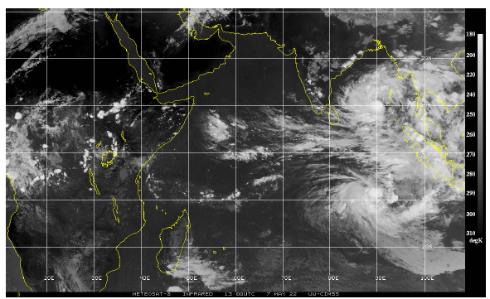
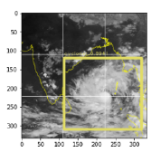
Cyclone Detections using YOLOv5 (1/2)
Fig: Shows the pre-processed image.
Fig: Shows the detected cyclone
Fig: Original image (2022-05-07, 12:00:00 hrs)
Fig: Shows the enlarged view of the detected cyclone ”Asani”
13

Slide 14
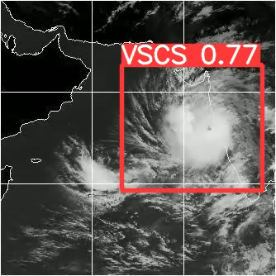
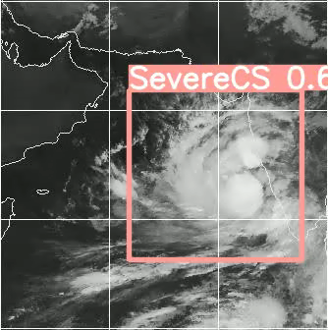
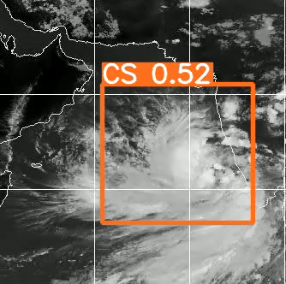
Cyclone Detections using YOLOv5 (2/2)
* video gifs
14

Slide 15
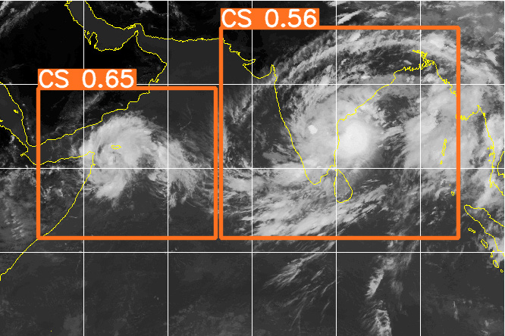
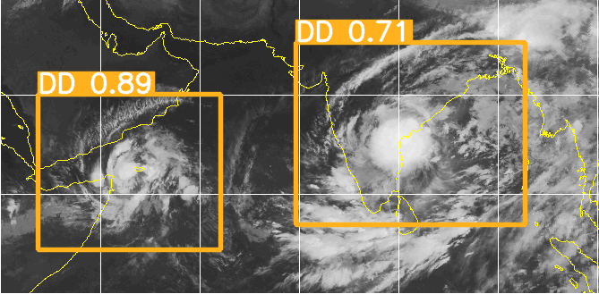
Multiple Cyclone Detections using YOLOv5
Detection of cyclones using YOLOv5 | Precision: 60% Recall: 96.9% mAP: 0.77 Accuracy over 2022 dataset: 89%
Fig: Multiple cyclone detections
15

Slide 16
References
[1] Liu, Y.; Racah, E.; Correa, J. Application of deep convolutional neural networks for detecting extreme weather in climate datasets. arXiv 2016, arXiv:1605.01156.
[2] Nakano, D.M.; Sugiyama, D. Detecting Precursors of Tropical Cyclone using Deep Neural Networks. In Proceedings of the 7th International Workshop on Climate Informatics, Boulder, CO, USA, 20–22 September 2017.
[3] Kumler-Bonfanti, C.; Stewart, J.; Hall, D. Tropical and Extratropical Cyclone Detection Using Deep Learning. J. Appl. Meteorol. Climatol. 2020, 59, 1971–1985.
[4] Giffard-Roisin, S.; Yang, M.; Charpiat, G. Tropical cyclone track forecasting using fused deep learning from aligned reanalysis data. Front. Big Data 2020, 3, 1.
[5] Cao, J.; Chen, Z.; Wang, B. Deep Convolutional networks with superpixel segmentation for hyperspectral image classification. In Proceedings of the 2015 IEEE International Geoscience and Remote Sensing Symposium
(IGARSS), Beijing, China, 10–15 July 2016; pp. 3310–3313.
[6] Li, Z.; Guo, F.; Li, Q.; Ren, G.; Wang, L. An Encoder–Decoder Convolution Network with Fine-Grained Spatial Information for Hyperspectral Images Classification. IEEE Access 2020, 8, 33600.
[7] Pan, S.J.; Tsang, I.W.; Kwok, J.T.; Yang, Q. Domain Adaptation via Transfer Component Analysis. IEEE Trans. Neural Netw. 2011, 22, 199–210.
[8] Yang, J.; Zhao, Y.; Chan, J. Learning and transferring deep joint spectral–spatial features for hyperspectral classification. IEEE Trans. Geosci. Remote Sens. 2017, 55, 4729–4742.
[9] Liu, X.; Sun, Q.; Meng, Y.; Fu, M.; Bourennane, S. Hyperspectral image classification based on parameter-optimized 3D-CNNs combined with transfer learning and virtual samples. Remote Sens. 2018, 10, 1425.
* shows only a few of the references
16

Slide 17
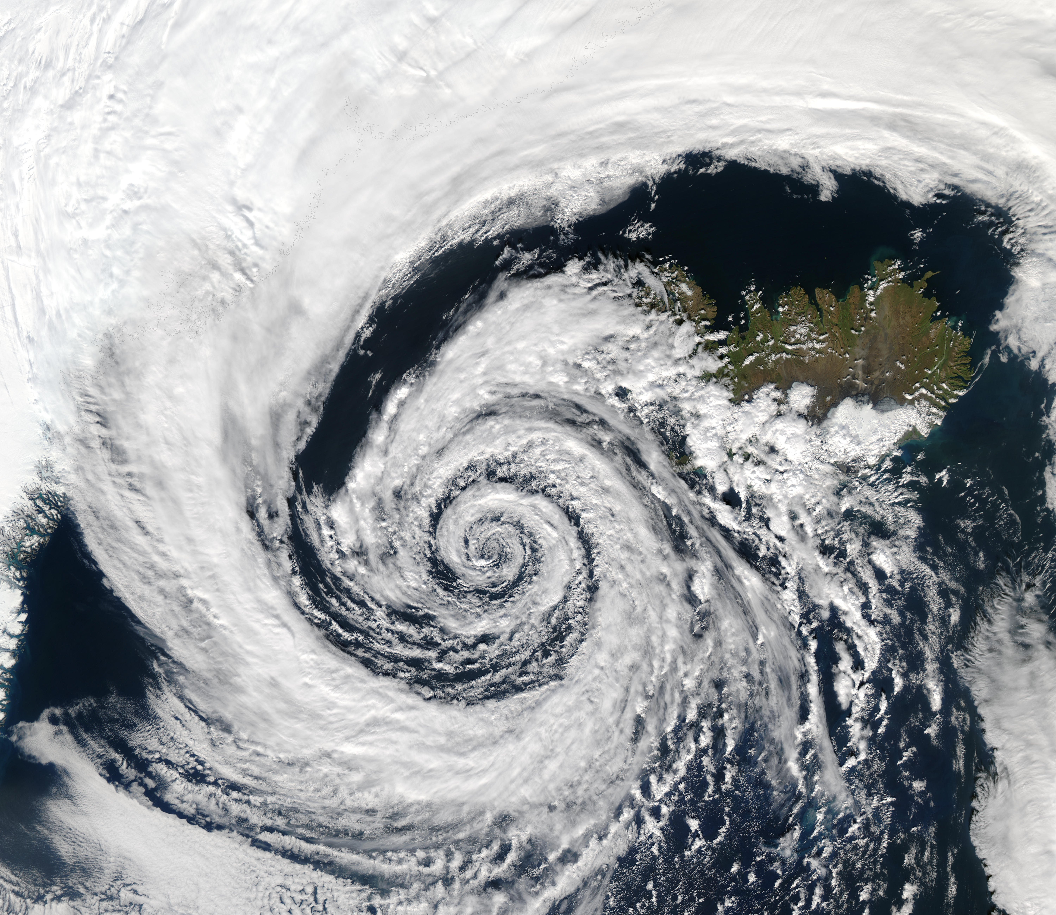
THANK YOU

